Slide 1


Three Not So Random Words Passwords vs Passphrases
May 2022
David Warburton Lead, Threat Research, F5 Labs
@warburtr0n

Slide 2

The 80/20 rule?
Notes:
CARPET
CODE
IT SUPPORT
What if I told you that just 20% of the carpet in your house takes 80% of the wear?
And what about if I claimed that 20% of your code is responsible for 80% of the vulnerabilities?
We often here about the 80/20 rule in IT and those people on 1st line support, it often feels like 20% of the support tickets take up 80% of the time.
I first heard about this 80/20 rule when I worked 1st line support…. but it isn’t just bizarre phenomenon in technology circles.
So where does this 80/20 come from … and what kind of RULE is it?

Slide 3

Solar flare intensities
Amount of traffic to websites
Earthquake magnitudes
Rate at which we forget
20% of patients take up 80% of healthcare resources
80% of Microsoft crashes caused by 20% of the bugs
Even linked to Covid-19 transmission
The Pareto Principle
Notes:
The Pareto Principle was first coined in 1896…it was named after the Italian economist Vilfredo Pareto who noted that 80% of the land in Italy was owned by just 20% of the population. The Parento Principle generally states that “20% of the input accounts for 80% of the output”.
And everywhere you look… the rule keeps popping. From economics, to city planning, to health and technology.
It can be seen when examining…
Solar flare intensities
Amount of traffic to websites
Earthquake magnitudes
Rate at which we forget
In the US, 20% of patients take up 80% of healthcare resources
In 2002, Microsoft stated that 80% of crashes in Windows and Office are caused by 20% of the bugs
RECENTLY… IT HAS EVEN BEEN SEEN TO EXIST IN COVID-19 RELATED TRANSMISSION
But in a recent preprint, Adam Kucharski of LSHTM estimated that k for COVID-19 is as low as 0.1. “Probably about 10% of cases lead to 80% of the spread,” Kucharski says.
Source: https://www.sciencemag.org/news/2020/05/why-do-some-covid-19-patients-infect-many-others-whereas-most-don-t-spread-virus-all

Slide 4

Zipf’s Law

Slide 5
Zipf’s Law
THE
OF
AND
TO
A
IN
IS
I
THAT
IT
FOR
YOU
WAS
WITH
ON
AS
HAVE
BUT
BE
THEY
1
rank
1
2
1
3
1
4
1
5
Notes:
THE OF AND…
The most common words in the entire English corpus. The word THE accounts for about 6% of everything we say! That’s kinda interesting, right?
Well American linguist George Zipf (1902–1950) noted that there was an interesting distribution to the words… in fact they follow a Pareto distribution!
So the 2nd most used word is used ½ as often
The 3rd most used word is used 1/3 as often
The 4th… ¼ as often, and so on!
Word occurrence is inversely proportional to its rank… ie. 1/rank
Not just English… every language… even ancient texts!
One of my favourite things is the term can use to describe this relationship… we refer to Zipfian distributions if entities exhibit this property… and many MANY things do.

Slide 6
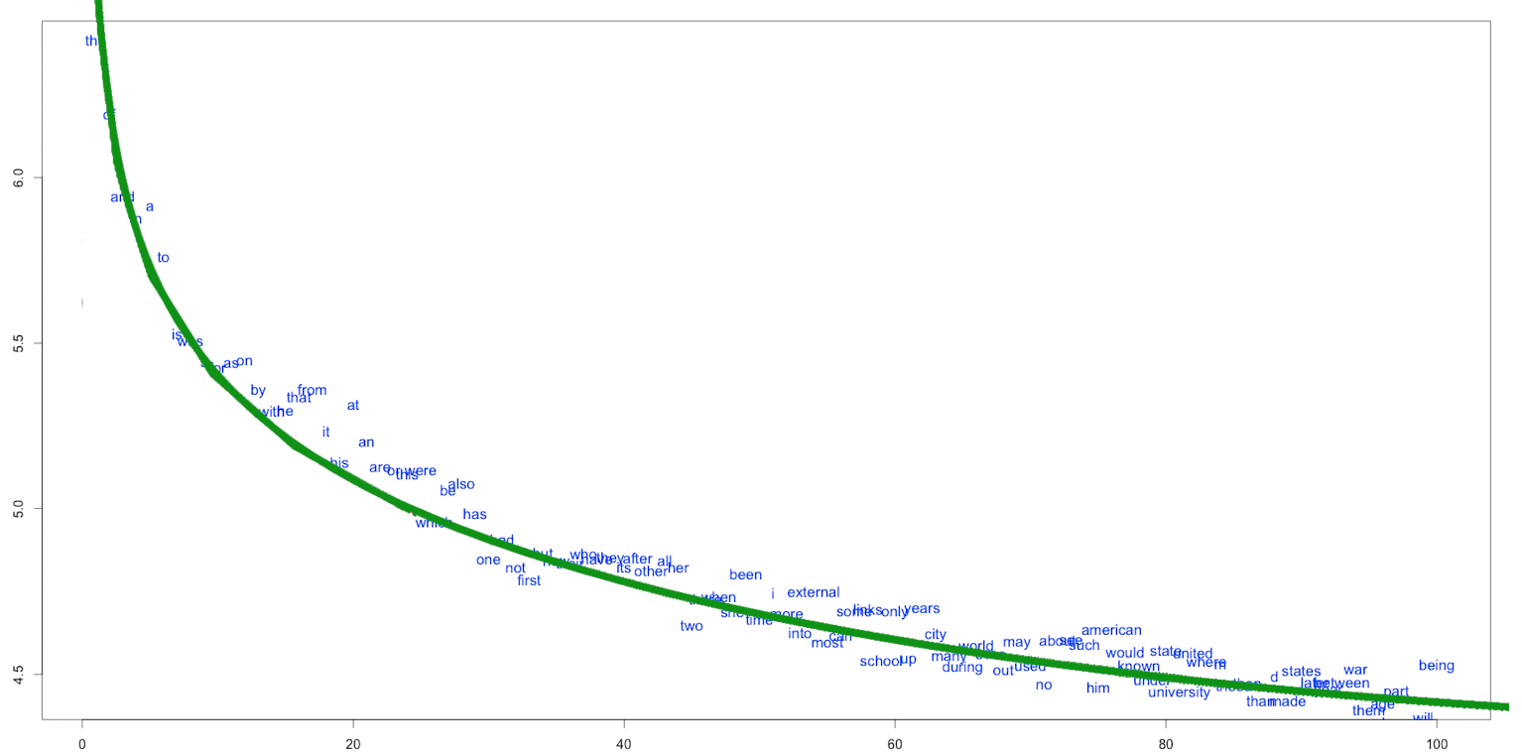
Zipf’s Law
100 Most Frequent Words in Wikipedia
Frequency (logged)
Frequency Rank
Notes:
Here’s an example using Wikipedia… just over the top 20 words account for 80% of everything written in all of the articles.
Top 25 most used words, account for 1/3 of what we say
Top 100 account for about half of what we say*
Top 18% of words used account for 80% of word occurrences
Roughly speaking
Nearly half of any book, article or news will be made up of the same 50-100 words
The other half will appear only once!
Source:
Vsauce – The Zipf Mystery
https://www.youtube.com/watch?v=fCn8zs912OE

Slide 7

123456
75%
most popular password for the past 7 years
of people re-use passwords
Principle of Least Effort
Notes:
But Zipf couldn’t explain it. And we still don’t have a good idea why…
One idea is that humans seem to naturally follow the principle of least effort.
The principle states that an “information-seeking client will tend to use the most convenient search method in the least exacting mode available. Information-seeking behavior stops as soon as minimally acceptable results are found. “
So we prefer shorter words and only use longer, of different words, when we really have to.
Maybe this explains why 123456 has been the most popular password for the past 7 years… or the fact that 75% of us reuse passwords from site to site.
Certainly, for me, my old passwords policy was the same password… maybe with the year at the end
Today I’m a little better… I use a password manager which creates unique passwords for me so I don’t have to even think about it. This, for me, is less effort than thinking of a new password for each site!

Slide 8
password
123456 12345 123456789 password iloveyou princess 1234567 rockyou 12345678 abc123 nicole daniel babygirl monkey lovely jessica 654321 michael ashley qwerty 111111 iloveu 000000 michelle tigger sunshine chocolate password1 soccer anthony friends butterfly purple angel jordan liverpool justin loveme f***you 123123 football secret andrea carlos jennifer joshua bubbles 1234567890 superman hannah amanda loveyou pretty basketball andrew angels tweety flower playboy hello elizabeth hottie tinkerbell charlie samantha barbie chelsea lovers teamo jasmine brandon 666666 shadow melissa eminem matthew robert danielle forever family jonathan 987654321 computer whatever dragon vanessa cookie naruto summer sweety spongebob joseph junior softball taylor yellow daniela lauren mickey princesa alexandra alexis jesus estrella miguel william thomas beautiful mylove angela poohbear patrick iloveme sakura adrian alexander destiny christian 121212 sayang america dancer monica richard 112233 princess1 555555 diamond carolina steven rangers louise orange 789456 999999 shorty 11111 nathan snoopy gabriel hunter cherry killer sandra alejandro buster george brittany alejandra patricia rachel tequiero 7777777 cheese 159753 arsenal dolphin antonio heather david ginger stephanie peanut blink182 sweetie 222222 beauty 987654 victoria honey 00000 fernando pokemon maggie corazon chicken pepper cristina rainbow kisses manuel myspace rebelde angel1 ricardo babygurl heaven 55555 baseball martin greenday november alyssa madison mother 123321 123abc mahalkita batman september december morgan mariposa maria gabriela iloveyou2 bailey jeremy pamela kimberly gemini shannon pictures a*****e sophie jessie hellokitty claudia babygirl1 angelica austin mahalko victor horses tiffany mariana eduardo andres courtney booboo kissme harley ronaldo iloveyou1 precious october inuyasha peaches veronica chris 888888 adriana cutie james banana prince friend jesus1 crystal celtic zxcvbnm edward oliver diana samsung freedom angelo kenneth master scooby carmen 456789 sebastian rebecca jackie spiderman christopher karina johnny hotmail 0123456789 school barcelona august orlando samuel cameron slipknot cutiepie monkey1 50cent bonita kevin b**** maganda babyboy casper brenda adidas kitten karen mustang isabel natalie cuteako javier 789456123 123654 sarah bowwow portugal laura 777777 marvin denise tigers volleyball jasper rockstar january ****off alicia nicholas flowers cristian tintin bianca chrisbrown chester 101010 smokey silver internet sweet strawberry garfield dennis panget francis cassie benfica love123 696969 asdfgh lollipop olivia cancer camila qwertyuiop superstar harrypotter ihateyou charles monique midnight vincent christine apples scorpio jordan23 lorena andreea mercedes katherine charmed abigail rafael icecream mexico brianna
RockYou
Notes:
RockYou (this is a glimpse at the top 400 passwords)
32 million records breached after simple SQL injection attack. Passwords stored in the clear!
SO WHAT HAVE ALL THESE DATA BREACHES TAUGHT US?
As a population… we are no better now than we were over 10 years ago
Keep using the same bad passwords
…and on multiple sites
Data breaches
Passwords in a DB – hashed or unhashed
Password files on servers, desktop computers
Improperly secured S3 buckets
Examples
Have I Been Pwned?
576,611,621 real passwords
Hashesorg2019
1,279,729,139
…and there are still larger lists

Slide 9
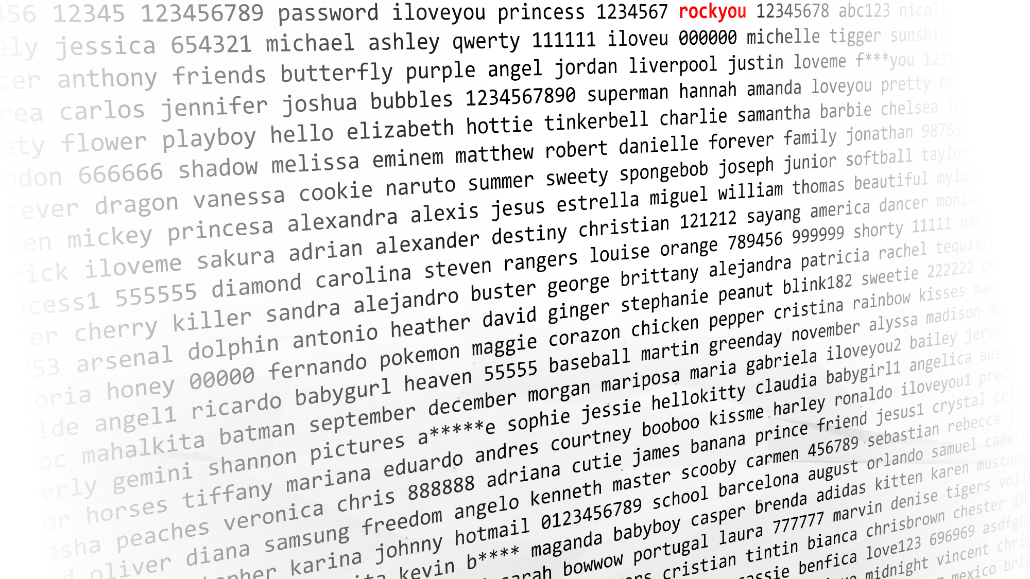
RockYou
SQL injection attack
32 million passwords
Stored in the clear
Notes:
RockYou (this is a glimpse at the top 400 passwords)
32 million records breached after simple SQL injection attack. Passwords stored in the clear!
SO WHAT HAVE ALL THESE DATA BREACHES TAUGHT US?
As a population… we are no better now than we were over 10 years ago
Keep using the same bad passwords
…and on multiple sites
Data breaches
Passwords in a DB – hashed or unhashed
Password files on servers, desktop computers
Improperly secured S3 buckets
Examples
Have I Been Pwned?
576,611,621 real passwords
Hashesorg2019
1,279,729,139
…and there are still larger lists

Slide 10
RockYou
123456 | 290,729
12345 | 79,076
123456789 | 76,789
password | 59,462
iloveyou | 49,952
princess | 33,291
1234567 | 21,725
rockyou | 20,901
12345678 | 20,553
abc123 | 16,648
nicole | 16,227
daniel | 15,308
babygirl | 15,163
monkey | 14,726
lovely | 14,331
jessica | 14,103
654321 | 13,984
michael | 13,981
ashley | 13,488
Notes:
RockYou (this is a glimpse at the top 400 passwords)
32 million records breached after simple SQL injection attack. Passwords stored in the clear!
SO WHAT HAVE ALL THESE DATA BREACHES TAUGHT US?
As a population… we are no better now than we were over 10 years ago
Keep using the same bad passwords
…and on multiple sites
Data breaches
Passwords in a DB – hashed or unhashed
Password files on servers, desktop computers
Improperly secured S3 buckets
Examples
Have I Been Pwned?
576,611,621 real passwords
Hashesorg2019
1,279,729,139
…and there are still larger lists

Slide 11
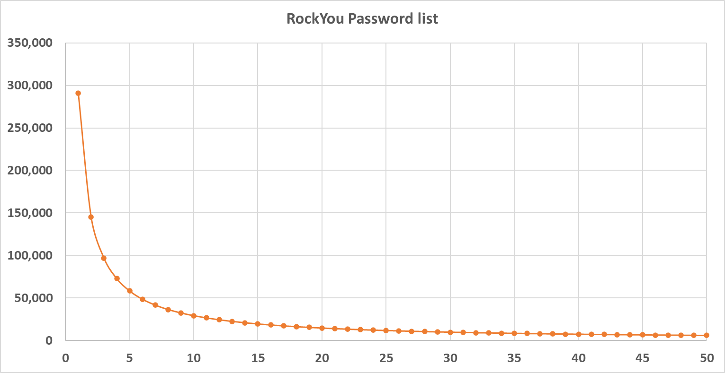
Zipfian Passwords
Notes:
How do passwords fair according to Zipfs law?
Not perfectly… but not bad!
Orange line = theoretical occurrence based on password rank

Slide 12
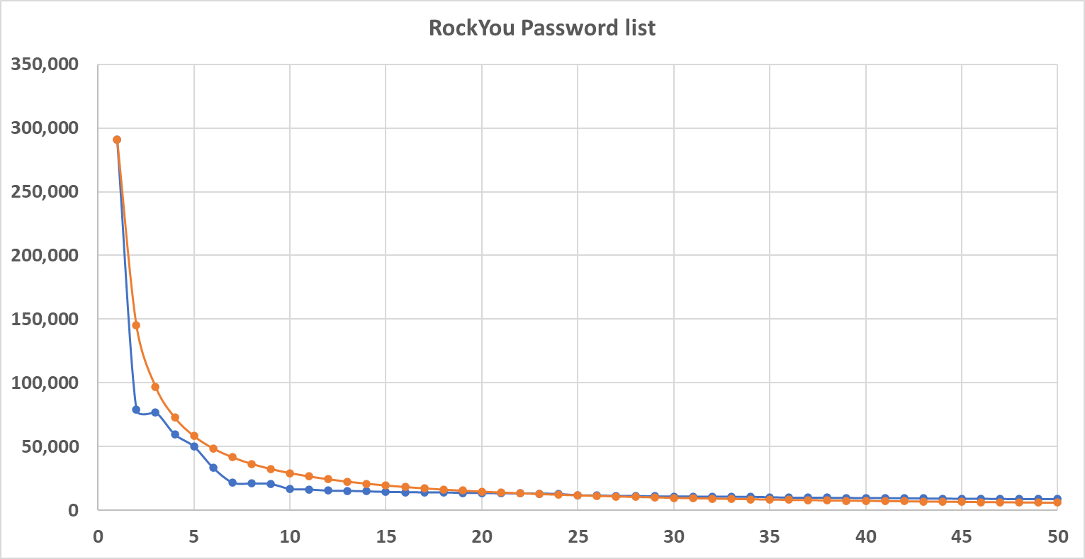
Zipfian Passwords
#1: ‘123456’
#26: ‘sunshine’
290,729
11,489
13,413,768 total passwords
12% of passwords =
80% of occurrences
Notes:
Orange line = theoretical occurrence based on password rank
Blue line = actual occurrence based on password rank
LETS DO SOME MATHS ☺ …
This isn’t true of just RockYou, but of every password list I’ve studied… including non-English ones.
Interestingly, in almost every case, the password pattern differs from a strict Parento distribution curve primarily with the 2nd password which is always significantly lower than the predicted curve

Slide 13
Password Attacks

Slide 14
F5 SIRT Incidents 2021
Notes:
25% of DoS incidents are Layer-7 (app)
Web exploits - mostly SQL injects

Slide 15
2021 Credential Stuffing Report
https://www.f5.com/labs/articles/threat-intelligence/2021-credential-stuffing-report
Notes:
5 years of data and research
3 new years of credential spills
Tested use of compromised credentials across 2.9 billion unique authentication attempts against Banks, Retail, Food and Beverage
https://f5.sharepoint.com.mcas.ms/sites/salesandmktg/sales/F5%20Labs/SitePages/2021-Credenti.aspx

Slide 16
2021 Credential Stuffing Report
credentials used
12 months
4 sites
30% found in
Collection X
Notes:
The analysis also traced logins across F5 customers using leaked credentials from Collection X, a massive set of leaked credentials that appeared for sale on a hacking forum in early 2019
It revealed two interesting insights
1- almost a 1/3 of all logins were with Leaked Credentials
2- out of these the majority of logins were legitimate users trying to login to their accounts using their real, but leaked, credentials – this is a ticking time bomb for the next ATO attack
https://www.f5.com/labs/articles/threat-intelligence/2021-credential-stuffing-report
https://f5.sharepoint.com.mcas.ms/sites/salesandmktg/sales/F5%20Labs/SitePages/2021-Credenti.aspx

Slide 17
2021 Credential Stuffing Report
Used by customers
credentials used
12 months
4 sites
30% found in
Collection X
Used by both
Used by attackers
Notes:
The analysis also traced logins across F5 customers using leaked credentials from Collection X, a massive set of leaked credentials that appeared for sale on a hacking forum in early 2019
It revealed two interesting insights
1- almost a 1/3 of all logins were with Leaked Credentials
2- out of these the majority of logins were legitimate users trying to login to their accounts using their real, but leaked, credentials – this is a ticking time bomb for the next ATO attack
https://www.f5.com/labs/articles/threat-intelligence/2021-credential-stuffing-report
https://f5.sharepoint.com.mcas.ms/sites/salesandmktg/sales/F5%20Labs/SitePages/2021-Credenti.aspx

Slide 18
2022 Application Protection Report
Notes:
Historical view, Application Tiers Model, unknowns removed
Malware up to 30% of breaches in 2021

Slide 19
Complex Passwords?
password
59,462
password1
11,112
Password1
449
Password_1
0*
* RockYou did not allow special characters
Notes:
After RockYou we realised we needed to require more complex passwords
Password complexity is made up of two things…
Length
Character set

Slide 20
Complex Passwords?
‘Must contain upper, number and special’
 | a-z | A-Z
Character 1 | 26 | 26 |  |  | 52
Character 2 | 26 | 26 |  |  | 52
Character 3 | 26 | 26 |  |  | 52
Character 4 | 26 | 26 |  |  | 52
Character 5 | 26 | 26 |  |  | 52
Character 6 | 26 | 26 |  |  | 52
Character 7 | 26 | 26 |  |  | 52
Character 8 | 26 | 26 |  |  | 52
 |  |  | 53,459,728,531,456
 |  |  | total permutations
 | a-z | A-Z | 0-9 | special
Character 1 | 26 | 26 | 10 | 8 | 70
Character 2 | 26 | 26 | 10 | 8 | 70
Character 3 | 26 | 26 | 10 | 8 | 70
Character 4 | 26 | 26 | 10 | 8 | 70
Character 5 | 26 | 26 | 10 | 8 | 70
Character 6 | 26 | 26 | 10 | 8 | 70
Character 7 | 26 | 26 | 10 | 8 | 70
Character 8 | 26 | 26 | 10 | 8 | 70
 |  |  | 576,480,100,000,000
 |  |  | total permutations
 | a-z
Character 1 | 26 |  |  |  | 26
Character 2 | 26 |  |  |  | 26
Character 3 | 26 |  |  |  | 26
Character 4 | 26 |  |  |  | 26
Character 5 | 26 |  |  |  | 26
Character 6 | 26 |  |  |  | 26
Character 7 | 26 |  |  |  | 26
Character 8 | 26 |  |  |  | 26
 |  |  | 208,827,064,576
 |  |  | total permutations
 | a-z | A-Z | 0-9 | special
Character 1 | 26 | 26 | 10 | 8 | 70
Character 2 | 26 | 26 | 10 | 8 | 70
Character 3 | 26 | 26 | 10 | 8 | 70
Character 4 | 26 | 26 | 10 | 8 | 70
Character 5 | 26 | 26 | 10 | 8 | 70
Character 6 |  | 26 |  |  | 26
Character 7 |  |  | 10 |  | 10
Character 8 |  |  |  | 8 | 8
 |  |  | 3,495,856,000,000
 |  |  | total permutations
208 billion
53 trillion
576 trillion (possible)
3 trillion
(likely)
* RockYou did not allow special characters
Notes:
Password complexity is made up of two things…
Length
Character set

Slide 21
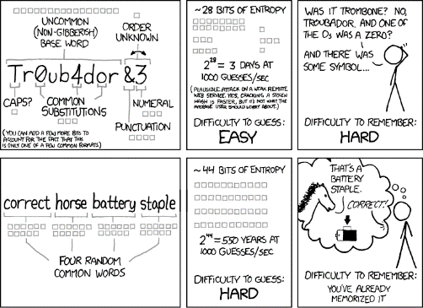


Passwords vs Passphrases
Passwords:
Not complex enough
Simple easy to guess iterations
Written down if complex
Re-used between sites
Passphrases:
Much longer
Easy to remember
correct horse battery staple
apple fish pen
https://xkcd.com/936/

Slide 22
Passwords vs Passphrases
password
26⁸
= 208,827,064,576 possible permutations
Tr0ub4dor_&3
72¹²
= 19,408,409,961,765,342,806,016
correct horse battery staple
26²⁸
= 4.1615368362200383420985518189585 x 10³⁹
Notes:
Password
208 BILLION possible combinations for an 8 character password using only a-z seems pretty good, right?
PROBLEMS
Only provides 2^38 bit security
Assumes attackers try every possible character combination from aaaaaaaaa to zzzzzzzz
2. Troubador&3
Well… we’ve increased our “key space” by using a-z and A-Z as well as 0-9 and special characters, let’s be generous and say it’s now
PROBLEMS
Not bad security…although number/character swapping is tested for my password cracking algorithms
Again, password cracking won’t try literally every character combination… it will work from a dictionary
So complex passwords are difficult… what about passphrases? Even the NCSC recommend “three random words”
The logic is sound…. assuming one attack vector: humans guessing your password.
But this is NOT what we need to protect ourselves against in the real world.

Slide 23
What about Zipf’s Law?
Top 18% of words used account for 80% of word occurrences
…and the Oxford English Dictionary has about 171,000 words (excludes technical terms)
…so that’s maybe 30,780 words in common use?
correct horse battery staple
26²⁸
= 4.1615368362200383420985518189585 x 10³⁹
897,582,676,390,560,000
‘Three Random Words’
30,780³
= 29,161,230,552,000
bite the bullet
10,000³
= 1,000,000,000,000
corre cthor sebatt eryst aple
Notes:
The logic is sound…. assuming one attack vector: humans guessing your password.
But this is NOT what we need to protect ourselves against in the real world.
This is actually significantly WEAKER than our Troubador password!
Assumptions…
People actually use all of those 30,000+ words…. many won’t…although some will use technical terms not in the OED
Password crackers know that they are attacking passphrases and not passwords
Research from University of Cambridge came to same conclusion as me… passphrases, as used in the real world, only offer about 20-bits of entropy:
https://www.lightbluetouchpaper.org/2012/03/07/some-evidence-on-multi-word-passphrases/

Slide 24
Password Hashing
password
SHA-1
5baa61e4c9b93f3f0682250b6cf8331b7ee68fd8
?
û
5baa61e4c9b93f3f0682250b6cf8331b7ee68fd8
SHA-1
û
123456
7c4a8d09ca3762af61e59520943dc26494f8941b
1234567
SHA-1
û
20eabe5d64b0e216796e834f52d61fd0b70332fc
monkey
SHA-1
û
ab87d24bdc7452e55738deb5f868e1f16dea5ace
SHA-1
ü
password
5baa61e4c9b93f3f0682250b6cf8331b7ee68fd8
Notes:
Sometime clear text passwords!! ☹
Sometimes hashed… but these can be “cracked”
What do we mean by cracked?
Hashes are one-way functions… you can’t take a hash e.g. ‘5baa61e4c9b93f3f0682250b6cf8331b7ee68fd8’ and revert that to the original password of ‘password’
BUT you can systematically guess if you know the most commonly used passwords…
A single computer can “crack” between…
5,000 hashes a second to
5,000,000 hashes a second!
The “weakpass_2a” password list
7,884,602,871 (almost 8 billion passwords)
Crackable in 3-4 hours

Slide 25
2021 Credential Stuffing Report
Password Hashing Algorithms Used
Notes:
Plaintext is the most prevalent data “storage” type in credential spill incidents.

Slide 26

Password Cracking
Hashcat
OpenCL API (OpenCL 2.1 AMD-APP (3380.6)) - Platform #1 [Advanced Micro Devices, Inc.]
=====================================================================================
* Device #2: AMD Radeon RX 5700 XT, 8064/8176 MB (6732 MB allocatable), 20MCU
-------------------
* Hash-Mode 0 (MD5)
-------------------
Speed.#2.........: 25221.4 MH/s (52.77ms) @ Accel:1024 Loops:1024 Thr:64 Vec:1
----------------------
* Hash-Mode 100 (SHA1)
----------------------
Speed.#2.........: 10150.5 MH/s (65.75ms) @ Accel:256 Loops:512 Thr:256 Vec:1
---------------------------
* Hash-Mode 1400 (SHA2-256)
---------------------------
Speed.#2.........: 4279.5 MH/s (78.01ms) @ Accel:256 Loops:256 Thr:256 Vec:1
----------------------------------------------------------------
* Hash-Mode 3200 (bcrypt $2*$, Blowfish (Unix)) [Iterations: 32]
----------------------------------------------------------------
Speed.#2.........: 21924 H/s (90.01ms) @ Accel:128 Loops:32 Thr:16 Vec:1
MD5: 25,221,400,000 H/s
SHA2: 4,279,500,000 H/s
bcrypt: 21,924 H/s

Slide 27
Password Cracking
hashcat.exe --force -a 0 -m 100 abc-sha1.hash rockyou.txt
Hashcat
OpNKorea.hash
Session..........: hashcat
Status...........: Exhausted
Hash.Mode........: 0 (MD5)
Hash.Target......: OpNKorea-md5.hash
Time.Started.....: Mon May 16 14:18:02 2022, (1 sec)
Guess.Base.......: File (rockyou.txt)
Guess.Queue......: 1/1 (100.00%)
Speed.#2.........: 19209.6 kH/s (1.46ms) @ Accel:2048 Loops:1 Thr:32 Vec:1
Recovered........: 2441/6393 (38.18%) Digests
Progress.........: 14344384/14344384 (100.00%)
…
461fcea38103a540fcec719b36d9e9d25f2c480a:waspwasp
e6aa9015ee04a14a6c91958f597304f129a016fd:waspss
bb98a8b9b1f23e284a4c67ee124ed2b1662753e1:warrandyte
746f638044a7f6d71ffd1da0719875b6108f93d4:wardrop
f8440d136e575d477888150e7137f96d543706f7:wanniassa
7898146f906308cb93e2c95fb60548b017e7cf89:wandal
3c30aad8375e70c080a1b1ee73ed0e0bb5500837:wanker6
b67ad6031ff5245df9ab1b0b088b244c680c2d6f:w3bster
00ff1c17090faf64e6705df7aa93861a24cc1a9f:volition
0aaa5b788c82645ec8021de310929798975b1ab0:vo2max
524fd67ad06b1c6d7072410a9ad2a528b56eb972:vito1234
d3bc80376ff4535075bc1d17432c6d224f580648:vishnu10
578ae09595212ab9578bc08d97cfe050e2b94bdb:virgo43
c1f803744a2de89edf9c412c21ca4e6df763bc31:virsag
6fb70286a21f732907a348229659d03dac212bc2:vince90
80afa46b957d29509f168949c34bbfe0df1c46fa:viewthis1
…
abc-sha1.hash
Session..........: hashcat
Status...........: Exhausted
Hash.Mode........: 100 (SHA1)
Hash.Target......: _hashes\abc-sha1.hash
Time.Started.....: Mon May 16 14:23:29 2022, (45 secs)
Guess.Base.......: File (_passwords\rockyou.txt)
Guess.Queue......: 1/1 (100.00%)
Speed.#2.........: 317.5 kH/s (1.44ms) @ Accel:2048 Loops:1 Thr:32 Vec:1
Recovered........: 17504/41583 (42.09%) Digests
Progress.........: 14344384/14344384 (100.00%)

Slide 28
Passphrase Cracking
Hashcat + passphrase list + permutations
Hashcat
1
2
3
1,976,271: energy air
1,976,272: aliomanu beach
1,976,273: from maryland to maine
1,976,274: thrikkakkara north
1,976,275: correct horse battery staple
1,976,276: qaleh ye na'im
1,976,277: leveling solvents
1,976,278: the urgent hangman
1,976,279: lac cloutier nord
correct horse battery staple
correct-horse-battery-staple
correct.horse.battery.staple
correct_horse_battery_staple
correcthorsebatterystaple
Correct horse battery staple
CORRECT HORSE BATTERY STAPLE
cORRECT HORSE BATTERY STAPLE
…
C0rr3ctH0rs3Batt3ryStapl3
C0rrect-Horse-Battery-Staple
correcthorsebatterystaple2022!
C0RRECT HORSE BATTERY STAPLE
…
Almost 22,000,000 passphrases
1,000 permutations of each phrase
https://github.com/initstring/passphrase-wordlist

Slide 29
Passphrase Cracking
hashcat -a 0 -m 0 passphrases_md5.hash passphrases.txt -r passphrase-rule1.rule -r passphrase-rule2.rule -O -w 3
Hashcat
passphrases.hash
Session..........: hashcat
Status...........: Exhausted
Hash.Mode........: 0 (MD5)
Hash.Target......: _hashes\passphrases_md5.hash
Time.Started.....: Mon May 16 15:03:55 2022 (19 secs)
Guess.Base.......: File (_passwords\passphrases.txt)
Guess.Mod........: Rules (rules\passphrase-rule1.rule, rules\passphrase-rule2.rule)
Guess.Queue......: 1/1 (100.00%)
Speed.#2.........: 1378.8 MH/s (0.41ms) @ Accel:2048 Loops:64 Thr:32 Vec:1
Recovered........: 2/4 (50.00%) Digests
Progress.........: 28406999376/28406999376 (100.00%)
dc774decf8a82893d3d1ae97d804c742:the long way around
9cc2ae8a1ba7a93da39b46fc1019c481:correct horse battery staple
‘apple fish pen’ not found

Slide 30
Passphrase Cracking
PRobability INfinite Chained Elements (PRINCE)
Hashcat
a b cc
a b cc cca cccc ccacc cccccc acccccc cccccccc cccccccccc cccccccccccc …
aa ccb acca ccbcc aacccc bcccccc aacccccc …
aaaabbbb baaabbbb abaabbbb bbaabbbb aababbbb bababbbb abbabbbb bbbabbbb aaabbbbb baabbbbb
…
Correct Horse Battery Staple
HorseHorseCorrectBattery HorseHorseBatteryBattery HorseCorrectCorrectHorse HorseBatteryCorrectHorse HorseCorrectBatteryHorse HorseBatteryBatteryHorse CorrectCorrectHorseHorse BatteryCorrectHorseHorse CorrectBatteryHorseHorse BatteryBatteryHorseHorse
https://github.com/hashcat/princeprocessor

Slide 31
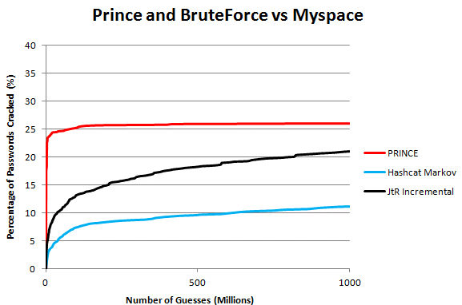
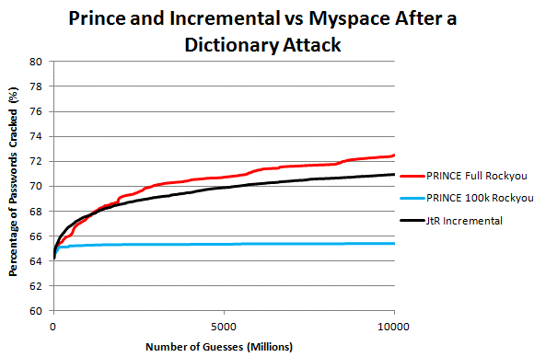
Passphrase Cracking
PRobability INfinite Chained Elements (PRINCE)
Hashcat
Using RockYou top 100,000 passwords
Using RockYou full password list
https://reusablesec.blogspot.com/2014/12/tool-deep-dive-prince.html
Notes:
Prince did really well starting out but then quickly became less effective. This is because it used most, (if not all), of the most common words in the RockYou list first so it acted like a normal dictionary attack. At the same time, Incremental Mode was starting to catch up by the end of the run. While I could continue to run this test over a longer cracking session, this actually brings up the next two experiments....

Slide 32
Real World Attacks

Slide 33
2021 Credential Stuffing Report
credentials used
12 months
4 sites
30% found in
Collection X
Notes:
The analysis also traced logins across F5 customers using leaked credentials from Collection X, a massive set of leaked credentials that appeared for sale on a hacking forum in early 2019
It revealed two interesting insights
1- almost a 1/3 of all logins were with Leaked Credentials
2- out of these the majority of logins were legitimate users trying to login to their accounts using their real, but leaked, credentials – this is a ticking time bomb for the next ATO attack
https://www.f5.com/labs/articles/threat-intelligence/2021-credential-stuffing-report
https://f5.sharepoint.com.mcas.ms/sites/salesandmktg/sales/F5%20Labs/SitePages/2021-Credenti.aspx

Slide 34
2021 Credential Stuffing Report
Used by customers
credentials used
12 months
4 sites
30% found in
Collection X
Used by both
Used by attackers
Notes:
The analysis also traced logins across F5 customers using leaked credentials from Collection X, a massive set of leaked credentials that appeared for sale on a hacking forum in early 2019
It revealed two interesting insights
1- almost a 1/3 of all logins were with Leaked Credentials
2- out of these the majority of logins were legitimate users trying to login to their accounts using their real, but leaked, credentials – this is a ticking time bomb for the next ATO attack
https://www.f5.com/labs/articles/threat-intelligence/2021-credential-stuffing-report
https://f5.sharepoint.com.mcas.ms/sites/salesandmktg/sales/F5%20Labs/SitePages/2021-Credenti.aspx

Slide 35
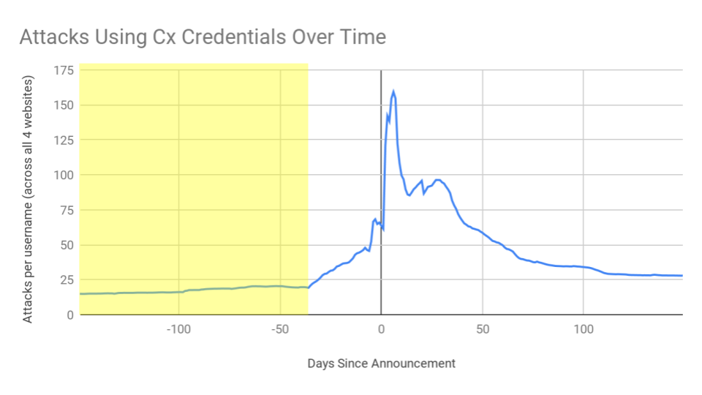
Attacker Use of Stolen Credentials
Stage 1: “Slow and Quiet”
Sophisticated threat actors operating in stealth mode -150 to -30 days before the public announcement.
Each credential used (on average) 20 times per day.

Slide 36
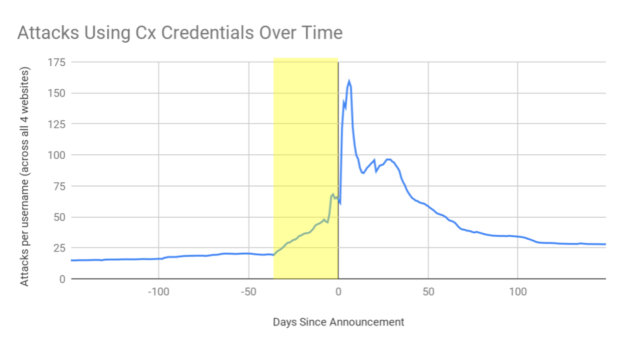
Attacker Use of Stolen Credentials
Stage 1: “Slow and Quiet”
Sophisticated threat actors operating in stealth mode -150 to -30 days before the public announcement.
Each credential used (on average) 20 times per day.
Stage 2: Ramp Up
Creds become available on Darknet around ~30 days before public announcement.
Script kiddies join in on the attack and the use of creds ramps up to 70 times per day.

Slide 37
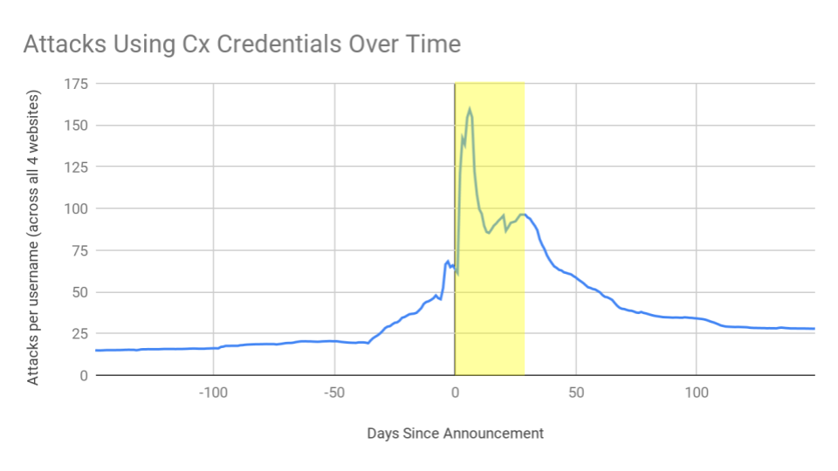
Attacker Use of Stolen Credentials
Stage 1: “Slow and Quiet”
Sophisticated threat actors operating in stealth mode -150 to -30 days before the public announcement.
Each credential used (on average) 20 times per day.
Stage 2: Ramp Up
Creds become available on Darknet around ~30 days before public announcement.
Use of creds ramp up to 70 times per day.
Stage 3: The Blitz
Credentials become public knowledge
Script Kiddies + N00bs
The first week is absolute chaos - each account attacked >130 times per day

Slide 38
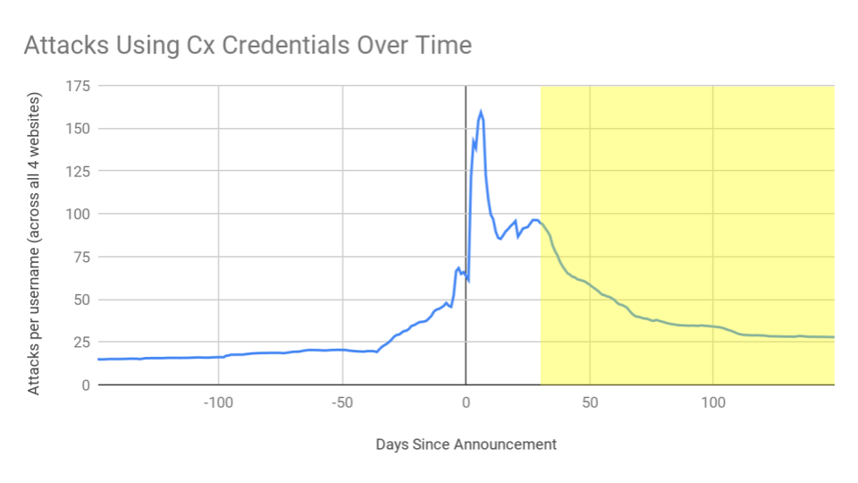
Attacker Use of Stolen Credentials
Stage 1: “Slow and Quiet”
Sophisticated threat actors operating in stealth mode -150 to -30 days before the public announcement.
Each credential used (on average) 20 times per day.
Stage 2: Ramp Up
Creds become available on Darknet around ~30 days before public announcement.
Use of creds ramp up to 70 times per day.
Stage 3: The Blitz
Credentials become public knowledge
Script Kiddies + N00bs
The first week is absolute chaos - each account attacked >130 times per day
Stage 4: Drop-Off / New Equilibrium
Creds *should* be worthless at this point…
Consumer reuse and lack of change allows for attacker “repackaging” and long tail value

Slide 39
Customer Attack Story
API Credential Stuffing
POST /oauth/oauth20/token HTTP/1.1
Host: api.victim.com
Connection: keep-alive
Accept-Encoding: gzip,deflate
Content-Type: application/x-www-form-urlencoded; charset=UTF-8
Content-Length: 162
User-Agent: Mozilla/5.0 (iPhone; CPU iPhone OS 13_2_3 like Mac OS X) AppleWebKit/605.1.15 (KHTML, like Gecko) Verion/13.0.3 Mobile/15E148 Safari/604.1
Pragma: no-cache
Accept: application/json, text/plain, */*
Origin: https://www.victim.com
Referer: https://www.victim.com/
Authorization: Atmostphere atmosphere_app_id=victim-7d4QgmLER0p4PIz0oUeccI92
X-Forwarded-For: 1.2.3.4
client_id=victim-7d4QgmLER0p4PIz0oUeccI92&client_secret=455b1c8d33a4f98903c1123c3264d5a908927065 &grant_type=password&password=************&username=asdf@gmail.com
Notes:
Anti-bot solutions can be really effective against web clients
Harder to mitigate API calls… can’t easily fingerprint, can’t inject JavaScript, can’t redirect or re-challenge

Slide 40
Customer Attack Story
API Credential Stuffing
POST /oauth/oauth20/token HTTP/1.1
Host: api.victim.com
Connection: keep-alive
Accept-Encoding: gzip,deflate
Content-Type: application/x-www-form-urlencoded; charset=UTF-8
Content-Length: 162
User-Agent: Mozilla/5.0 (iPhone; CPU iPhone OS 13_2_3 like Mac OS X) AppleWebKit/605.1.15 (KHTML, like Gecko) Verion/13.0.3 Mobile/15E148 Safari/604.1
Pragma: no-cache
Accept: application/json, text/plain, */*
Origin: https://www.victim.com
Referer: https://www.victim.com/
Authorization: Atmostphere atmosphere_app_id=victim-7d4QgmLER0p4PIz0oUeccI92
X-Forwarded-For: 1.2.3.4
client_id=victim-7d4QgmLER0p4PIz0oUeccI92&client_secret=455b1c8d33a4f98903c1123c3264d5a908927065 &grant_type=password&password=************&username=asdf@gmail.com
Previously stolen app-ID and secret
Credential stuffing attack
Notes:
Anti-bot solutions can be really effective against web clients
Harder to mitigate API calls… can’t easily fingerprint, can’t inject JavaScript, can’t redirect or re-challenge

Slide 41
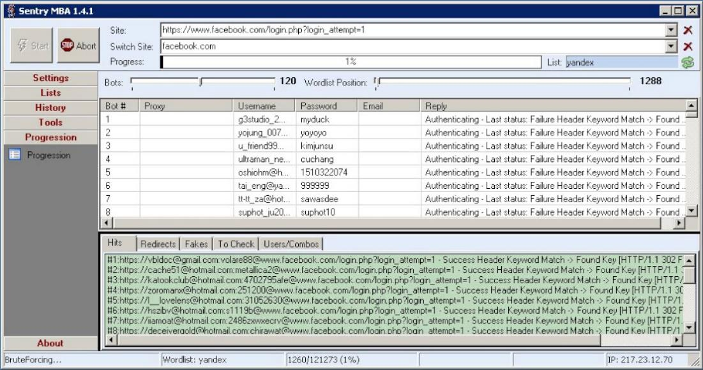
Customer Attack Story
API Credential Stuffing
Credentials from Previous Breaches
USERNAME
USERNAME
USERNAME
USERNAME
USERNAME
USERNAME
USERNAME
USERNAME
USERNAME
USERNAME
USERNAME
USERNAME
USERNAME
USERNAME
Notes:
41
© 2018 F5 Networks

Slide 42
What Have We Learned?

Slide 43
Recommendations
People
Process
Technology
Train
Not just how
Why?
Random & unique
Consider expiration policies
Removal all defaults
Block top passwords
Password managers
Monitoring
API protection
Bot detection
Notes:
Future of Authentication…?
Authentication, particularly password policies, are hard to get right
Always a risk vs usability trade off
Especially a problem when dealing with so much automated attack traffic
People, Processes, Technology…
People: Train users properly… not just to use ‘good’ passwords… but WHY… what happens? What are the consequences and WHAT IS THE LIKELIHOOD (i.e. RISK)
User training can reduce successful phishing campaigns by a 1/3
Processes: check for commonly re-used password. Reconsider password policies and expiration dates
Technology: Implement authentication mechanism covivering ALL internal and external systems
Enterprise level password manager
Federated access with strong posture checks and MFA

Slide 44
f5.com/labs

